Slide 1
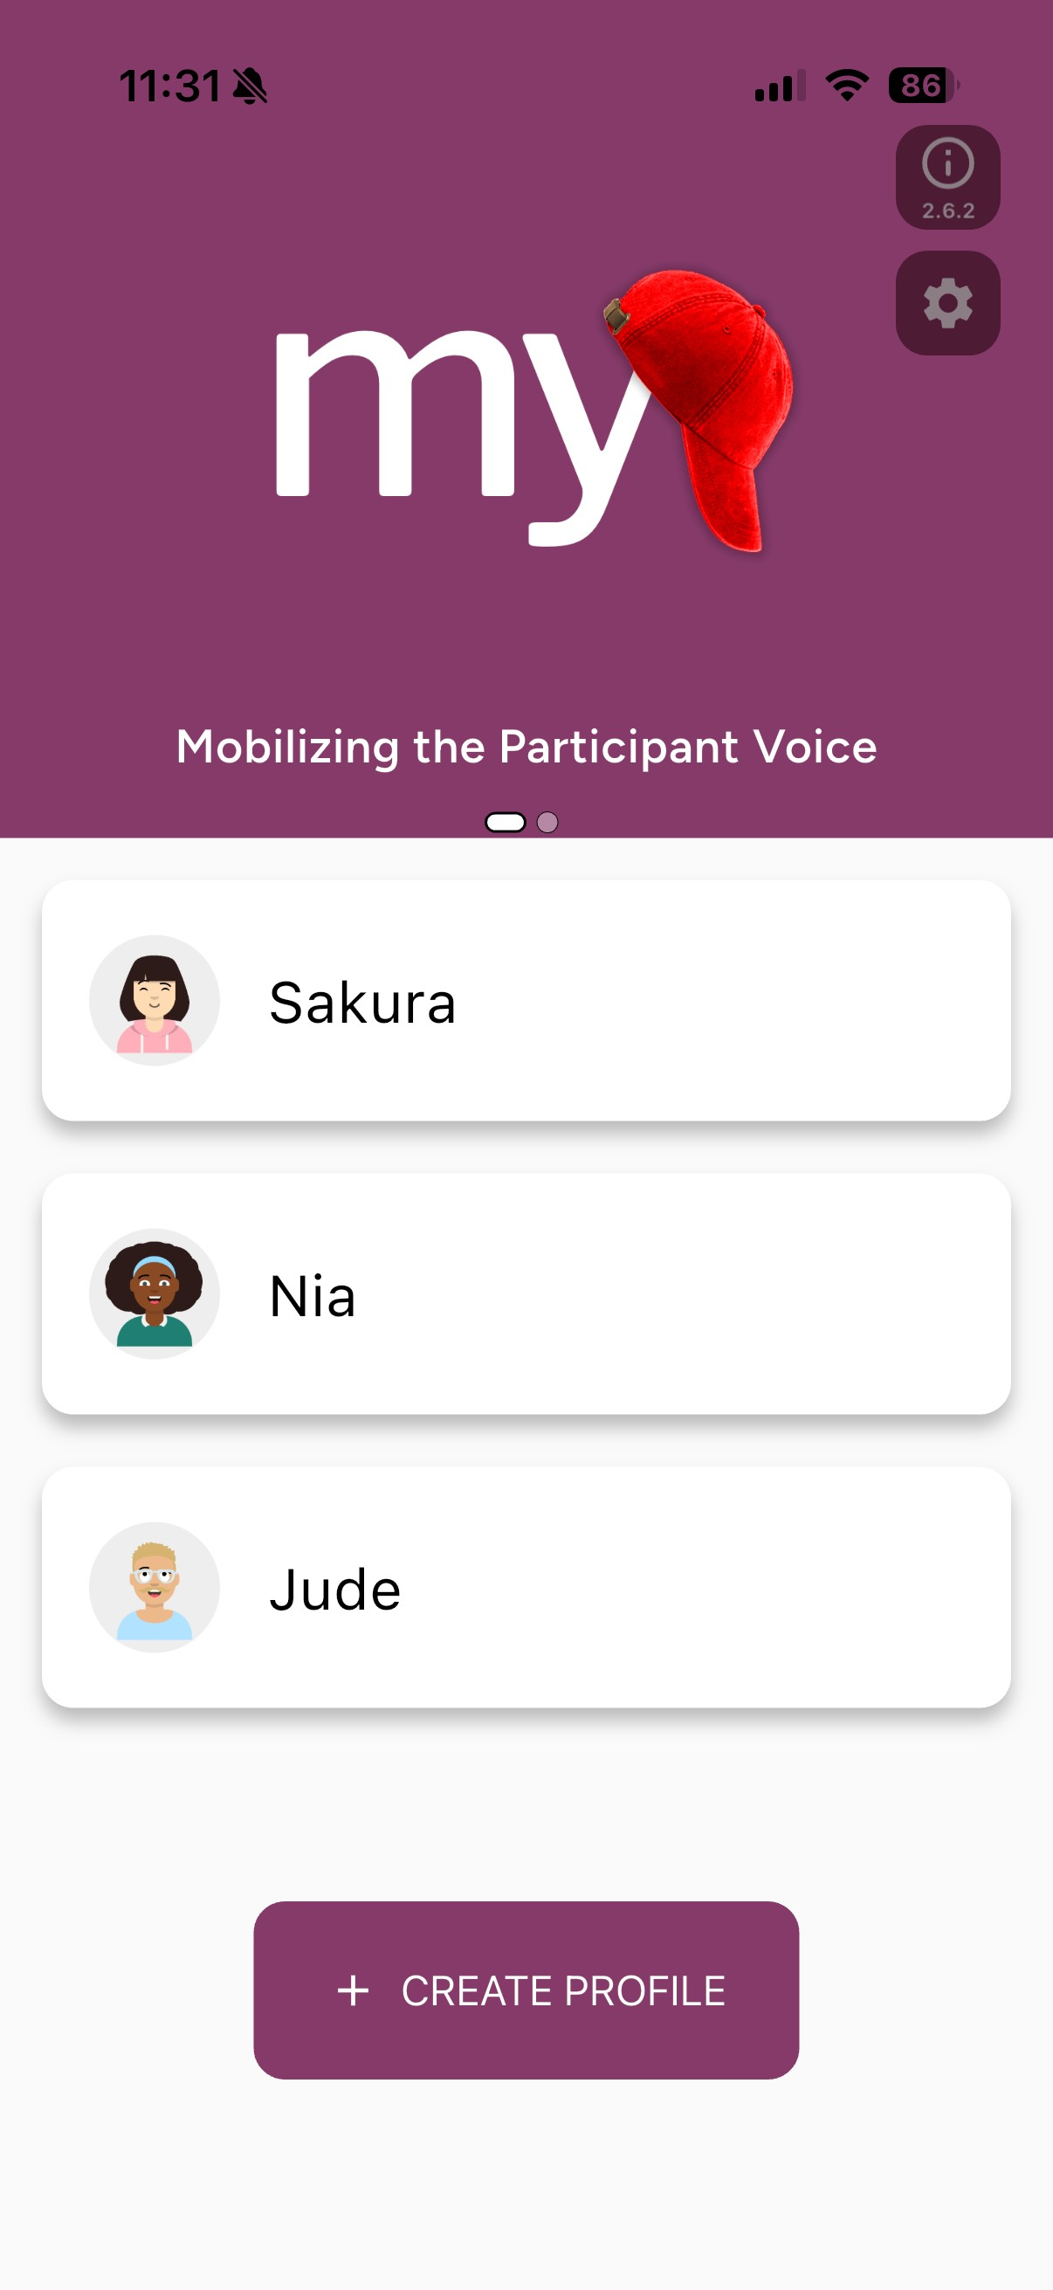
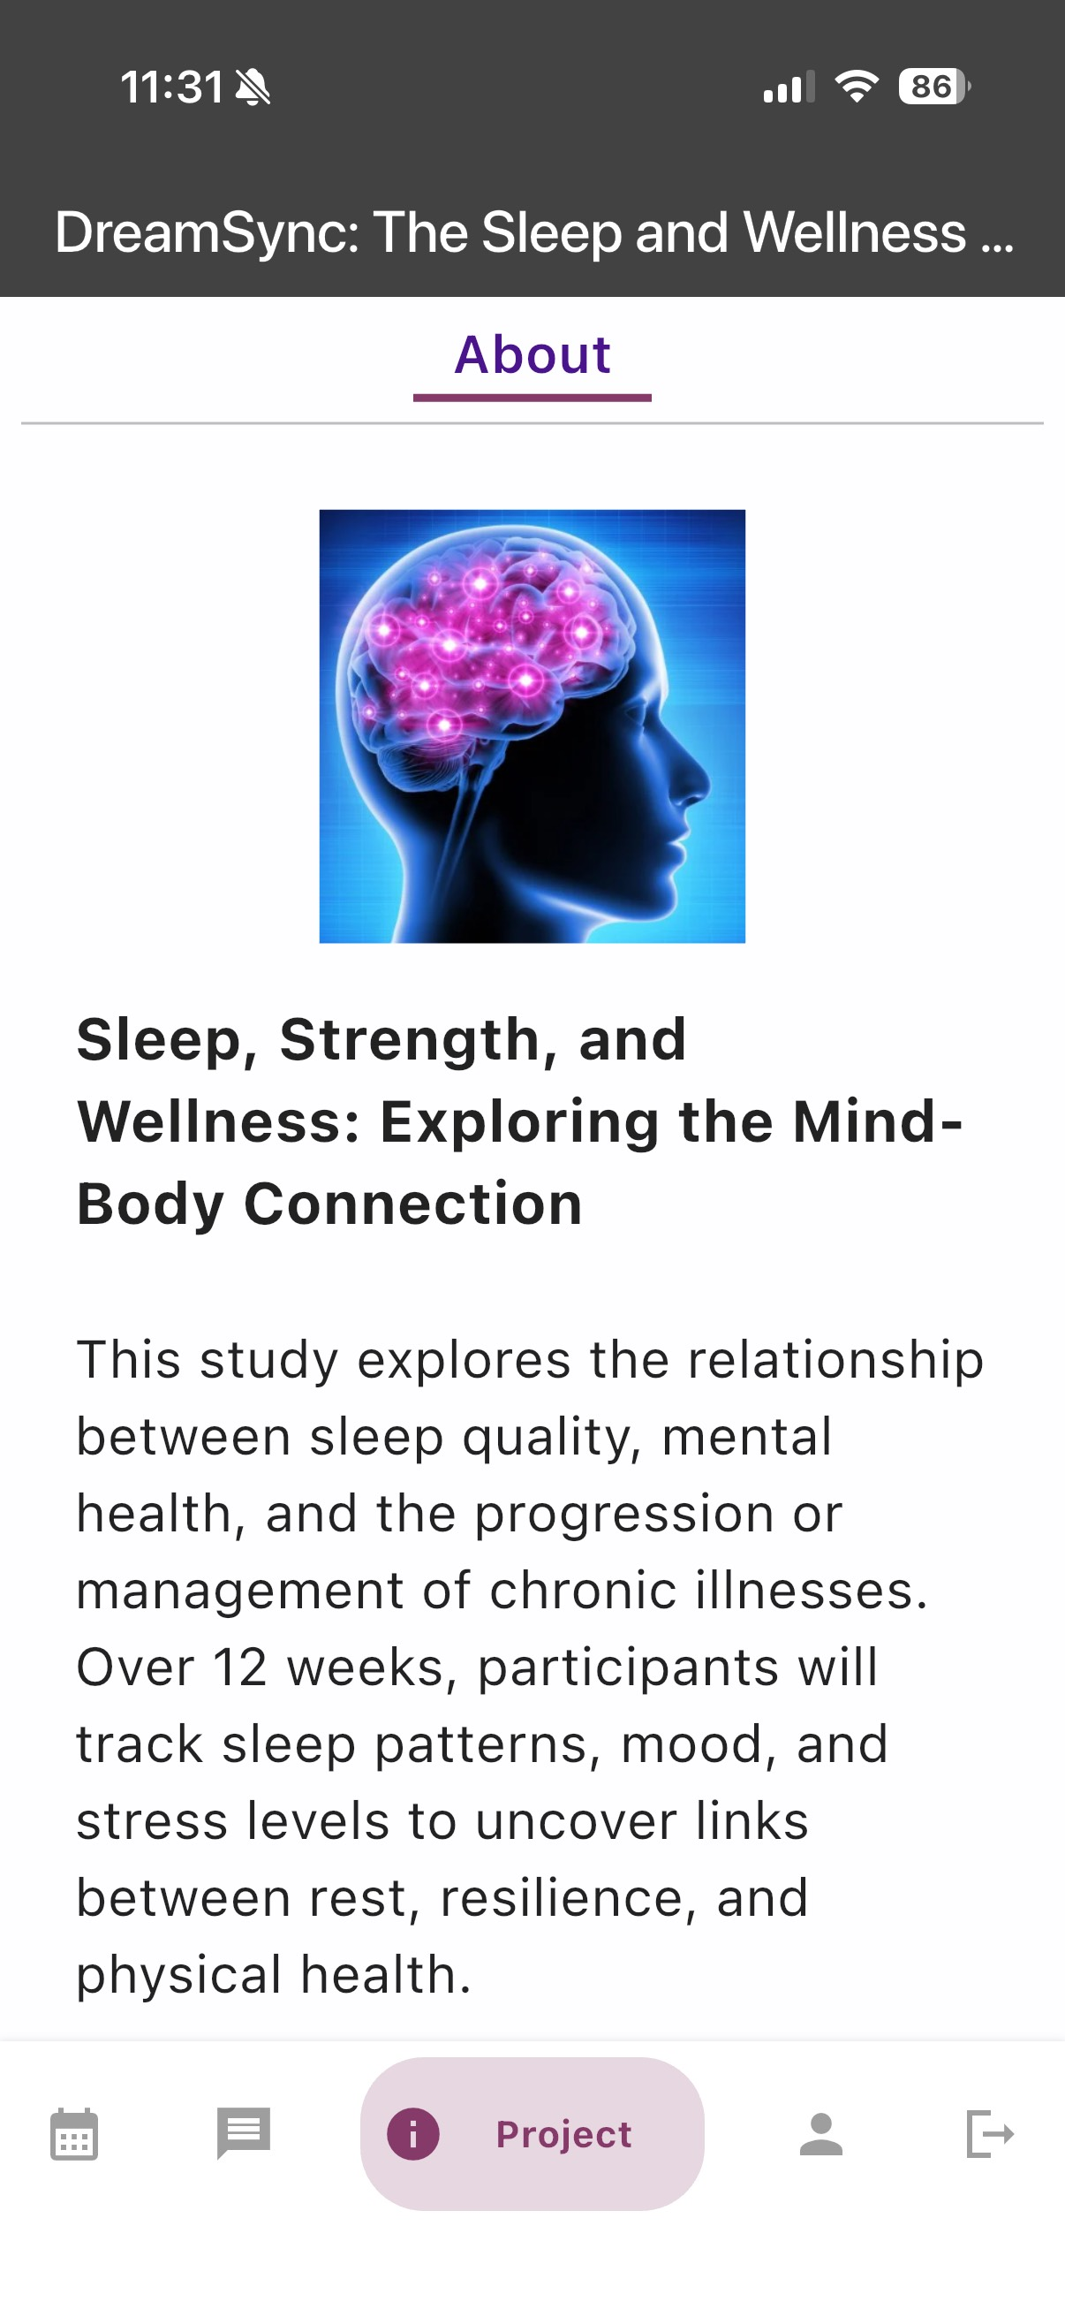
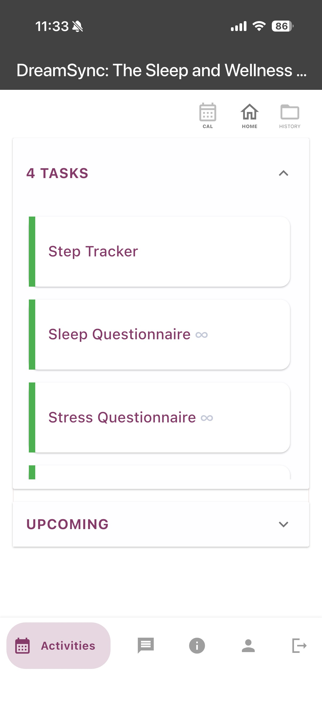
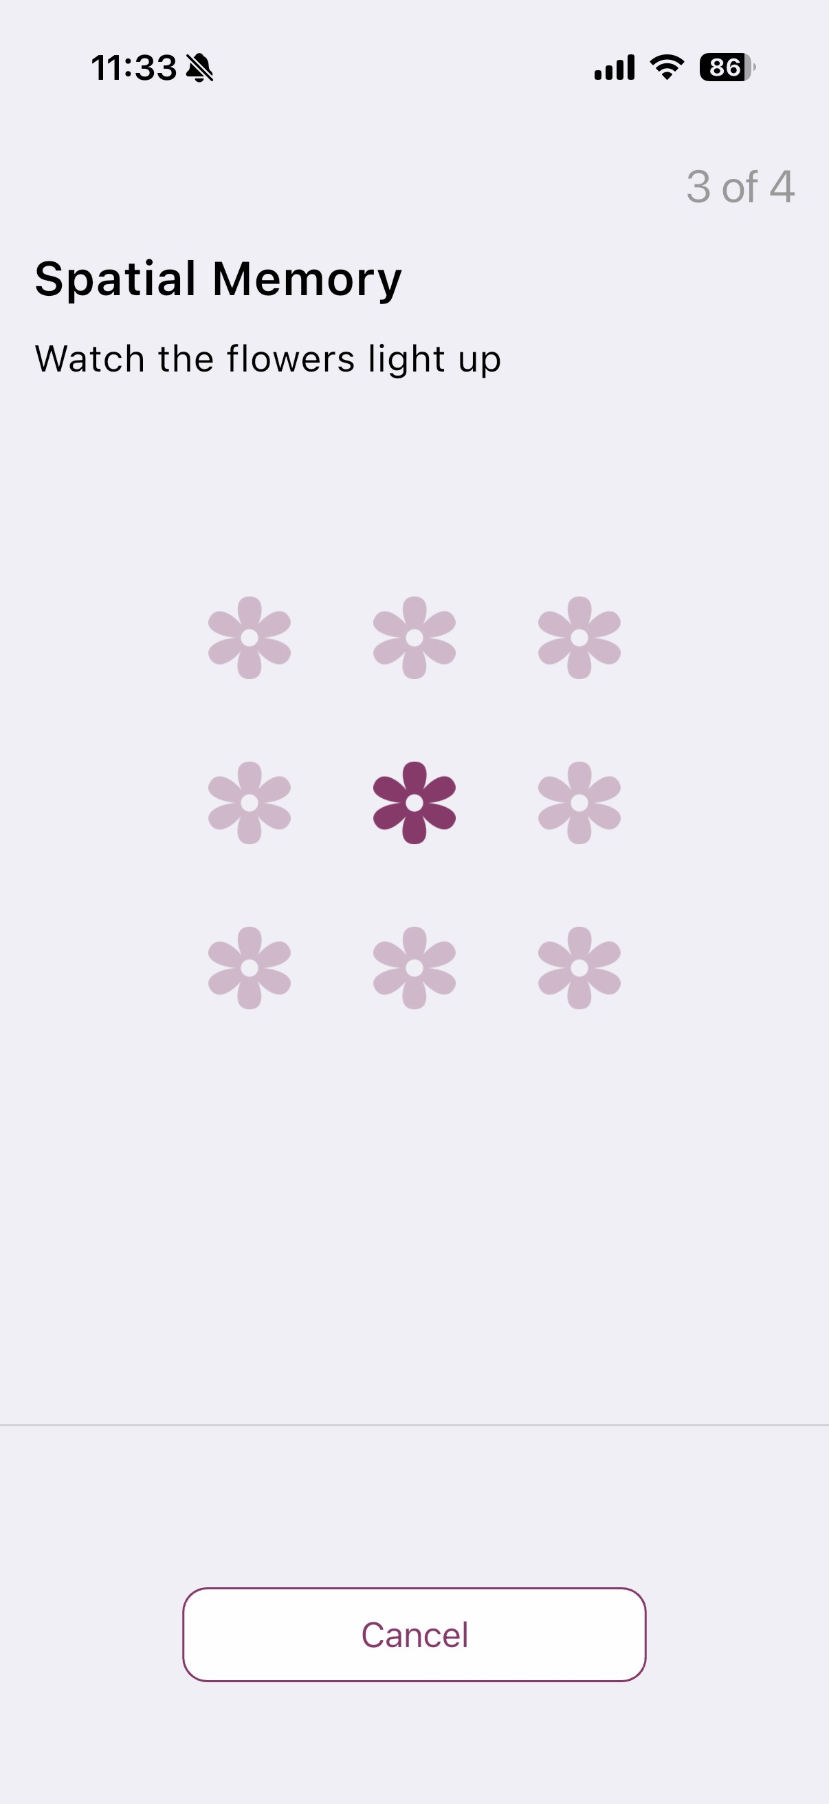
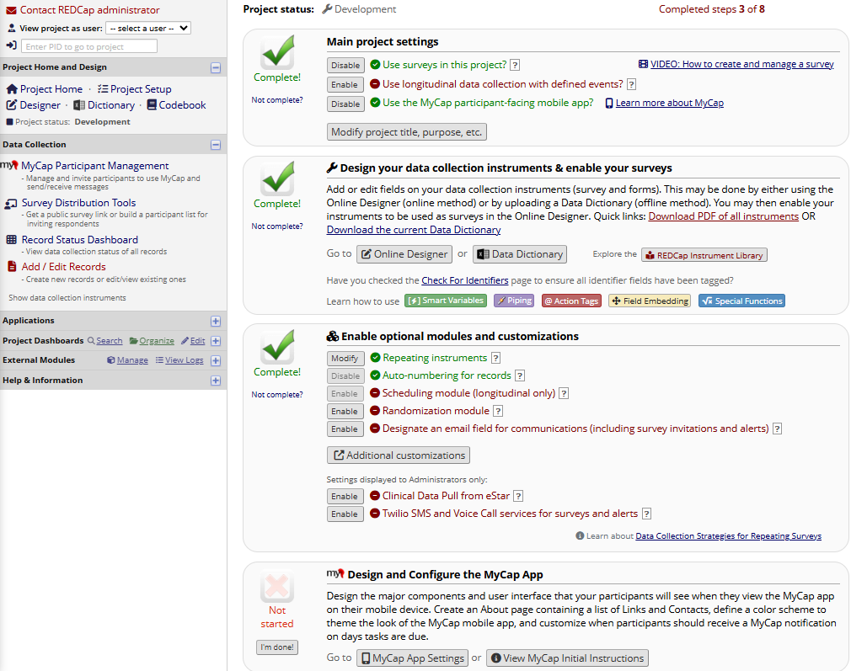
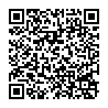

MyCap Utilization
WHAT IS MYCAP?
A tool for researchers – a free, customizable participant-facing mobile application to capture patient reported outcomes based a REDCap project.
MyCap Profiles
About Page
Survey Tasks
Active Tasks
37,169
Participants
9,193
Projects
1,216
Institutions
90
Countries
About Page
A tool for participants – a central study ‘home’ for study activities, communications, and resources supporting continuous participant engagement and participant retention.
MYCAP FEATURES
IS MY PROJECT A GOOD FIT?
Customizable task schedules with in-app notifications on days tasks are due
Supports multiple participants per device and multiple projects per participant
Offers return of results to ensure maximum value for participants
Available in 20 languages and integrated
Bi-directional, in-app messaging
Pre-designed measures (Active Tasks) to capture physiologic data using device sensors (microphone, speaker, gyroscope)
Some remote participation (not in clinic)
Recurring data collection or frequent touchpoints
Use of Active Tasks or Mobile Toolbox
Bi-directional messaging
Multiple methods of participant engagement
Participant access to mobile device
Mobilizing the Participant Voice: Using the MyCap App to engage participants from anywhere.
Required:
Optional:
PARTICIPANT FEEDBACK
STUDY TEAM FEEDBACK
Use of MyCap was evaluated in a study exploring financial incentives for study participants (n=286):
90% reported that MyCap was very or extremely easy to use
85% reported that it was very or extremely easy to complete tasks
76% reported that it was very or extremely easy to complete Active Tasks
“We wanted to make the test as simple and convenient as possible for the participants while maintaining the highest levels of privacy, efficiency, + data + sample integrity.”
- Simon Mallal, MD, Covid-19 Surveillance Study
“We were all over the country and MyCap allowed us to work together really well.”
- Julia Phillippi, MSN, CNM, PhD, Labor Study
“It (MyCap) saved countless man hours which would have been spent making weekly phone calls to subjects to document ILI symptoms.”
- Angela Branch, MD, Vaccine Trial
“The app is what made the study feasible- there is no way we could have done it if we hadn’t used the app in the way we did.”
- Allison Carroll, MD, MPH, Medication Error Study
Scan the QR Code to Demo MyCap
MYCAP EXAMPLE USE CASES
Use Case | Participant Activity
Active Labor Study- A collaborative team of five academic institutions evaluated the usability of MyCap for real-time patient-reported data collection during latent labor. | Recorded contraction frequency and duration once labor began; recorded symptoms and coping mechanisms as latent phases progressed.
Medication Error Study- A study team at VUMC evaluated the use of a health literacy-informed communication intervention to reduce medication discharge errors for pediatric patients. *TOP TEN ARTICLES OF THE YEAR FOR PEDATRIC HOSPITAL MED IN 2024* | Parents photographed the syringe after drawing the medication and uploaded it to MyCap. Also completed surveys on med name, dose, frequency, adverse effects, and other details.
Parkinson’s Disease Identification- Weill Cornell used MyCap to identify patients from Healthy Controls by utilizing the Tapping Active Task. | Active tapping task 2x about 1 hour apart, 3 days per week, for 5 weeks on MyCap.
COVID-19 Surveillance- Vanderbilt University Medical Center used MyCap to link participant samples with test results in a COVID-19 surveillance study at a local high school. | Weekly saliva samples and symptom questionnaires. MyCap’s barcode scanning feature linked sample test tubes to test results, which were pushed to participants’ app.
Assessing the Impact of Anti-Depressant Medication Usage on Circadian Clock-The Turner Institute for Brain & Mental Health in Melbourne is using MyCap to study the effects of antidepressants on the circadian clock and the impact of sleep/light exposure on mood. | Logged daily symptoms and physiologic data in MyCap, which were monitored by clinical staff to identify when triage or in-person care was needed.
Ready to get started? Join the MyCap Community today, utilized by*:
6.5k projects, 934 institutions, and 23.5k participants across 82 countries
*As of April 2025

